Slide 1
Modernize and Automate Data Integration
Qlik Data Integration Platform
November 2020

Slide 2
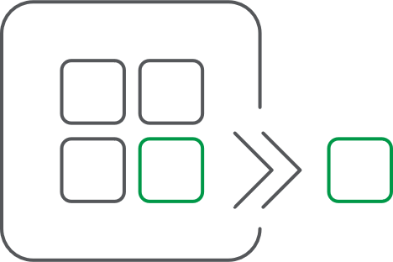
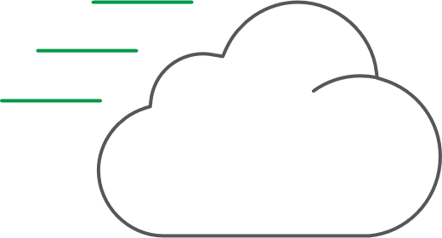


Modernize and Automate Data Integration
Efficiently capture large volumes of changed data from heterogeneous sources and deliver analytics ready data in real-time to Cloud Platforms where it can be catalogued for discovery and provisioning to Analysts and Data Scientists
LEADER IN CHANGE DATA CAPTURE
Most comprehensive platform supportability matrix
Modern architecture & UI
End-to-end offering captures changed data and delivers analytics ready data
Publish to BI and Data Science tools
MARKET LEADER IN CLOUD INTEGRATION SOLUTIONS
Relied on by the top cloud computing providers
Migrated and integrated more than 200,000 databases and mainframes to AWS, Azure and Google
Complete cloud data delivery and catalog capabilities, closes the last mile
LEADER IN EASE OF USE AND AUTOMATION
Automated mapping, target table creation and data instantiation
Quickly create and deploy analytics ready structures
Catalog, inventory, search and retrieve data for use at scale

Slide 3





Modernize and Automate Data Integration
1. REAL-TIME
Architected from the ground up for real-time changed data capture and analytics-ready data delivery
2. HETEROGENEOUS
Seamlessly move real-time data between heterogeneous systems
Connect on-premise systems with Cloud environments
Move data between Cloud providers
One platform
3. COMPLETE & AUTOMATED
Initial instantiation
Target table creation
Automated mappings
Schema synchronization
Data Warehouse, Data Mart and Data Lake creation
Catalog data assets
Publish to BI and Data Science tools
4. SCALE & STABILITY
Relied on by more than 2,500 customers, including half of the Fortune 100
R&D scale to embrace ever-changing tech landscape
Deep expertise in data, data integration and analytics

Slide 4










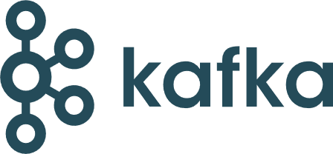




Trends Driving Integration Modernization & Automation
DB
DB
DATA
CONSUMPTION & ANALYTICS
DB
MF
MF
IaaS PaaS
MF
IaaS PaaS
Data Lake
Micro
Services
DWaaS
EDW
EDW
EDW
SaaS
FILES
FILES
FILES
CLOUD APPLICATION DEVELOPMENT
Legacy application modernization
Faster, easier new application development
Higher scalability/elasticity
Infrastructure and maintenance cost savings
Requires real-time data from on-premise systems
DATA WAREHOUSE MODERNIZATION
Reduce the costs associated with legacy EDW’s and provide elasticity
Meet new business requirements
Support more advanced analytics
Data Warehouse Automation replaces traditional ETL with modern self-service capabilities
Requires real-time data from on-premise systems and cloud platforms
NEXT GENERATION ANALYTICS & DATA MONETIZATION
Analyze a broader set of data structures along with structured data
Needs organization and intuitive search
Leverage AI/ML, IoT and decision automation for a competitive advantage
Requires Managed Data Lake Creation and Big Data processing at scale
Requires real-time data from on-premise systems and cloud platforms

Slide 5
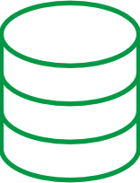


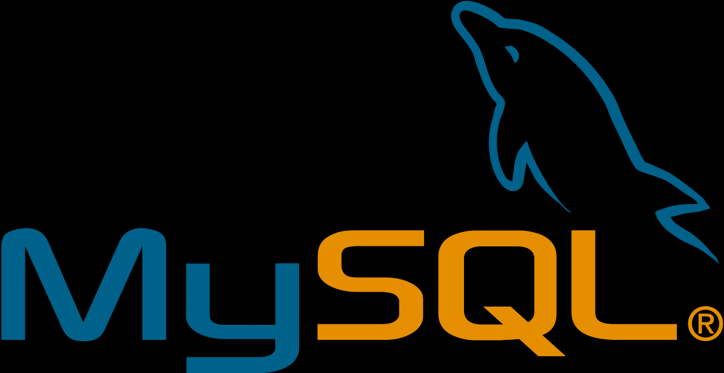
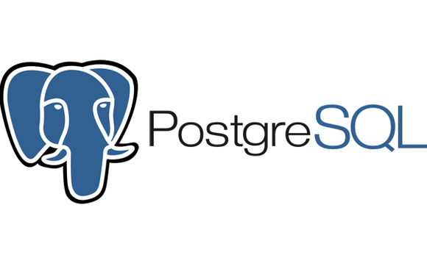
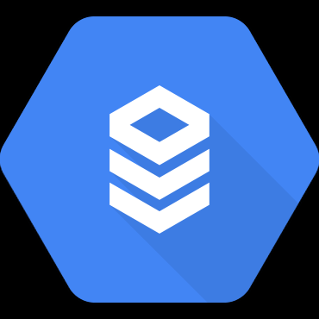
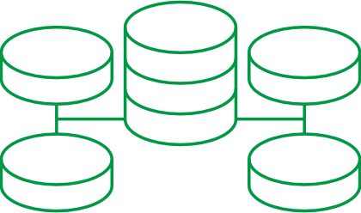
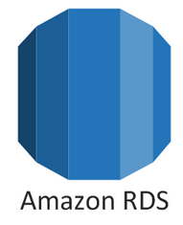

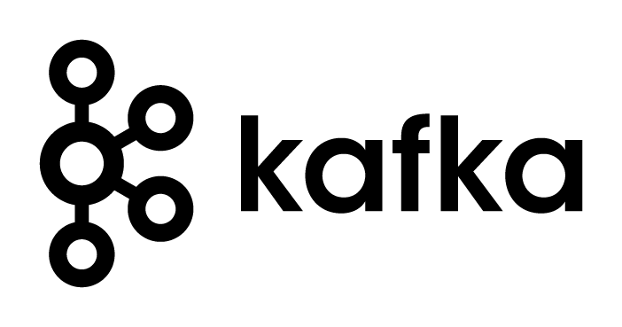



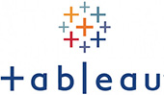
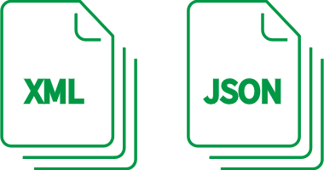

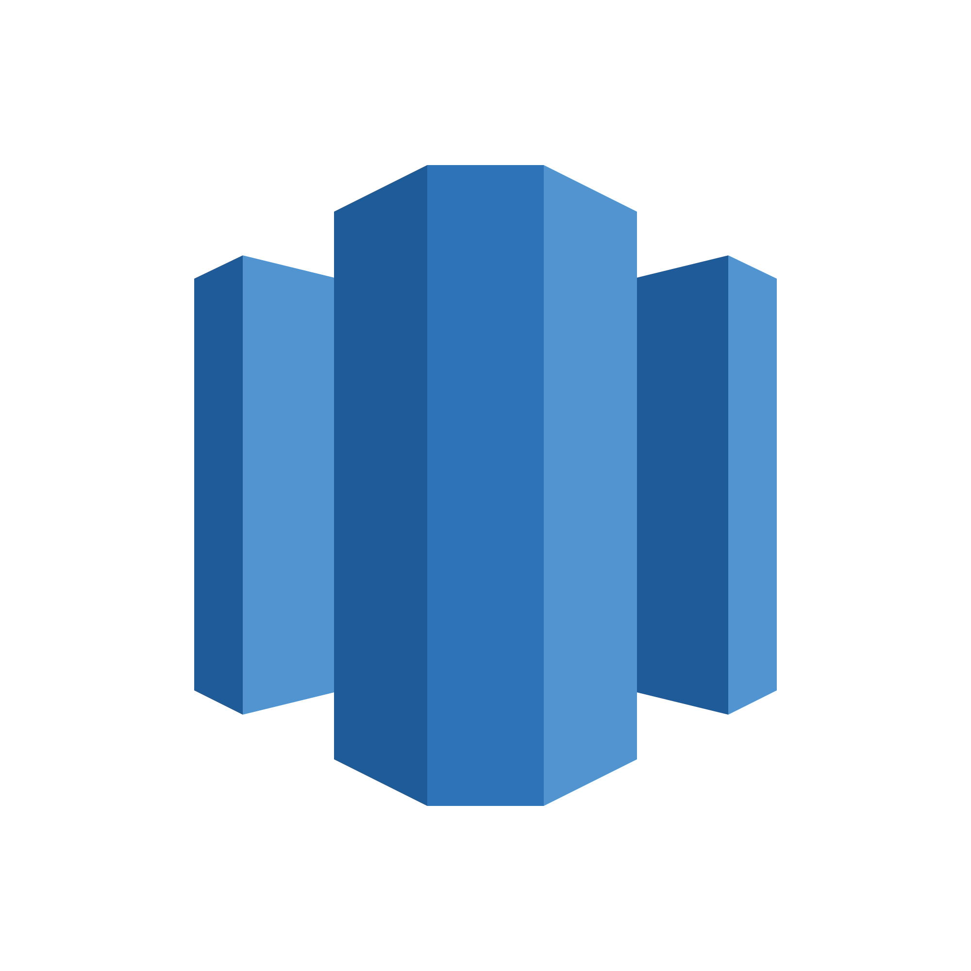

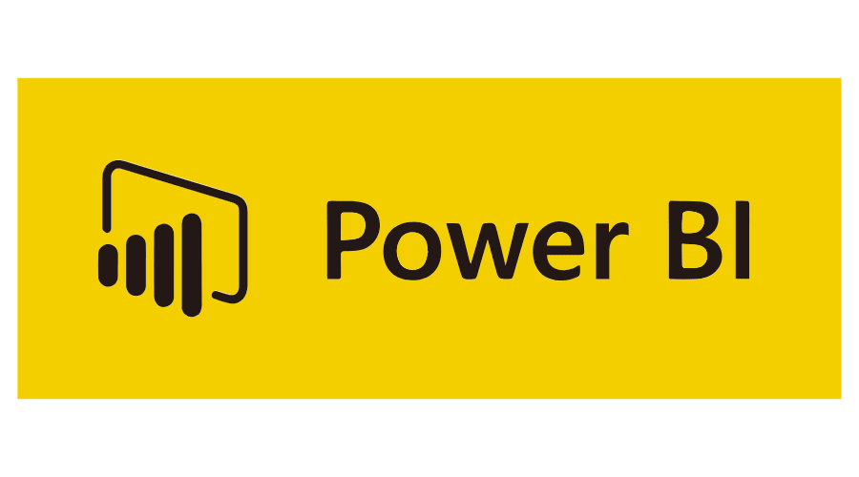
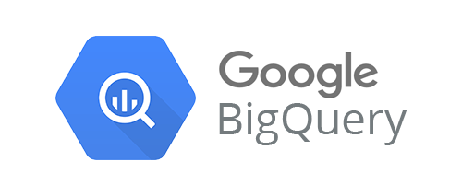
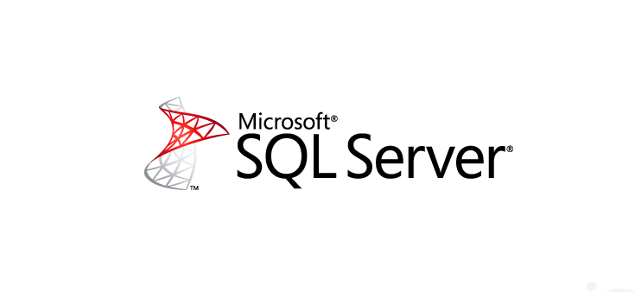
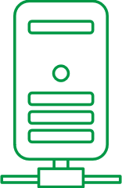
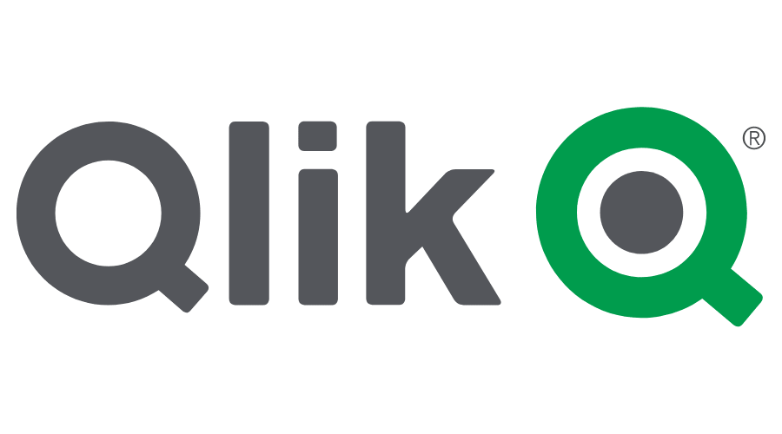


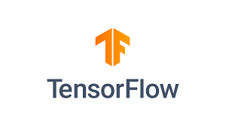
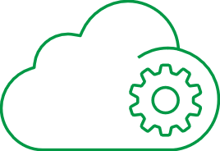
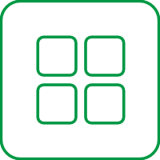

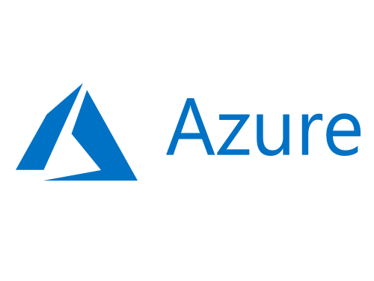
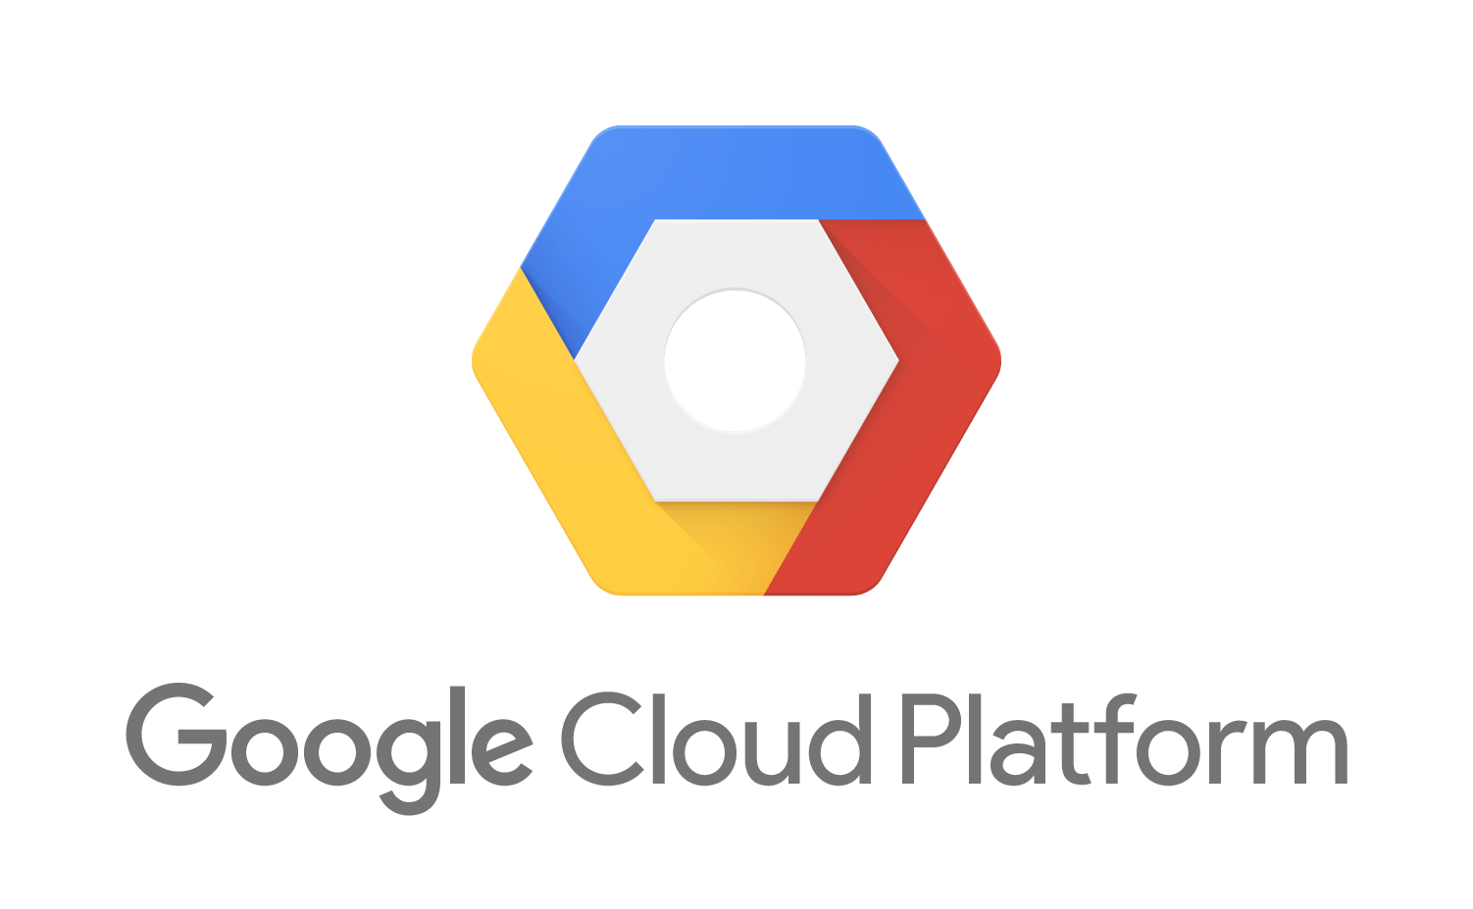




Modernize, Automate & Simplify DI with Analytics-ready Data Delivery
RDBMS
CDC Streaming
Streaming Data Pipeline Automation
Google Cloud SQL
Data Warehouse
Commit
Amazon RDS
Azure SQL DB
Files
Data Warehouse Automation
Amazon Redshift
Azure Synapse
Analytics
Mainframe
Generate
Deliver
Refine & Merge
Model
SAAS
Change Data Streams
To Clouds, Lakes…
For Analytics, AI/ML, Data Science…
Catalog
Shop, Organize & Provision
Consume
AI/ML
APPS
Managed Data Lake Creation
Design, Manage & Monitor
SAP
Conform
Data Science
Catalog
Shop, Organize & Provision

Slide 6










QDI - Platform Supportability Matrix
SOURCES
TARGETS
DL/DW Automation
Database
Mainframe
SAP
AWS
Azure
Google
Oracle
SQL Server
DB2 iSeries
DB2 z/OS
DB2 LUW
MySQL (+ MariaDB, Percona)
PostrgeSQL
Sybase ASE
Informix
SAP HANA
ODBC
DB2 z/OS
IMS/DB
VSAM
COBOL Copybooks
ECC (DB: Oracle, SQL Server, DB2 LUW, HANA **)
ERP
CRM
SRM
GTS
MDG
HANA **
SAP Extractor
RDS (MySQL, Postgres, MariaDB, Oracle, SQL Server)
Aurora (MySQL, Postgres)
S3
EMR
Kinesis
Redshift
Snowflake
Databricks
DBaaS (SQL DB)
DBaaS (MySQL, Postgres)
ADLS Gen1 & 2
BLOB
HDInsight
Event Hub
Synapse (SQL DW)
Snowflake
Databricks ( Delta )
Cloud SQL (MySQL, Postgres)
Cloud Storage
Dataproc
BigQuery
Snowflake
Cloud
Cloud
Oracle Cloud
Amazon RDS (SQL Server, Oracle, MySQL, Postgres)
Amazon Aurora (MySQL)
Amazon Aurora (PostgreSQL)
Amazon Redshift
Azure SQL Server MI
Azure Database for MySQL
Google Cloud SQL (MySQL, PostgreSQL*)
Oracle Cloud
SaaS
Data Lake
EDW
Database
EDW
Salesforce
Cloudera / Hortonworks / Cloudera Data Platform (CDP) Private Cloud
MapR
Amazon EMR
Azure HDInsight
Google Dataproc
Oracle Autonomous DB (cloud)
Exadata
Teradata
Netezza
Vertica
Sybase IQ
SAP HANA
Microsoft PDW
Oracle
SQL Server
DB2 LUW
MySQL ( + MariaDB, Percona)
PostgreSQL
Sybase ASE
Informix
MemSQL
ODBC
Exadata
Teradata
Netezza
Vertica
Pivotal
Flat Files
NoSQL
Delimited (e.g., CSV, TSV)
Streaming
MongoDB
Kafka (Apache & Confluent)
Amazon Kinesis
Azure Event Hubs
MapR Streams
SAP
Flat Files
* No CDC
** Trigger-based
SAP HANA (database)
Delimited (e.g., CSV, TSV)
Please refer to latest support matrix for full list.

Slide 7











Comprehensive Partner Ecosystem
Major Cloud Platforms:
Fast Growing Platforms:
(KAFKA)
(SPARK)
Hadoop Evolution:
Production Systems:
Notes:
Delivering these benefits requires close collaboration and integration with modern data ecosystems. As a sampling, Qlik Data Integration platform integrates with production sources such as IBM, including mainframe systems, as well as Oracle databases and SAP applications. Qlik automates the delivery and refinement of this data on all major targets, including Hadoop platforms, emerging high-growth platforms like Confluent, Databricks and Snowflake, and the three primary cloud service provide platforms.

Slide 8

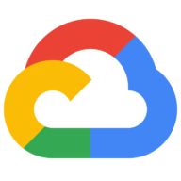

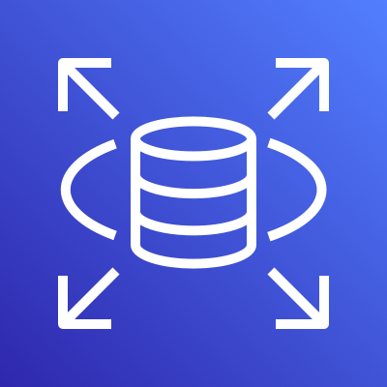
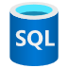
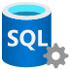
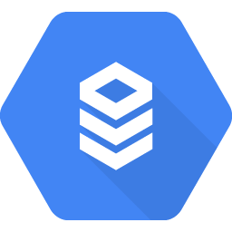





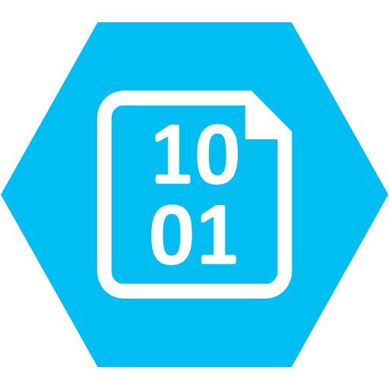
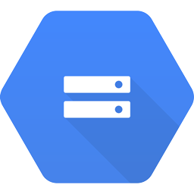
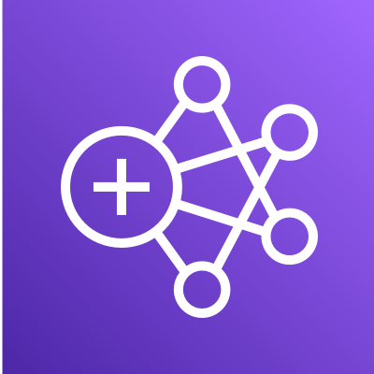




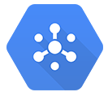

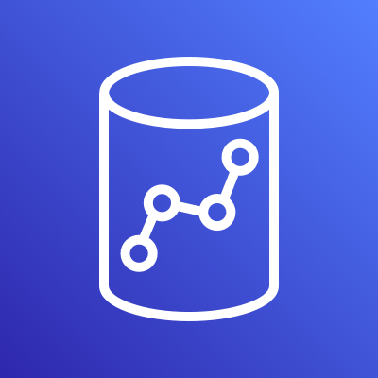
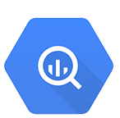


QDI - Cloud Partner Alignment
DL/DW Automation
RDS (All)
All databases
All databases
DBaaS
S3
ADLS , BLOB
GCS
STORAGE
EMR
HDInsight
DataProc
HADOOP
STREAMING
Kinesis
Event Hubs
Kafka
Redshift
Azure Synapse
BigQuery
DWaaS
Snowflake
Snowflake
Snowflake
OTHER DWaaS
Databricks
Databricks
SPARK
Please refer to latest support matrix for full list.

